Slide 1

Maximum & Minimum
RCET 0264 Introductory Calculus
Tim Leishman

Slide 2
Maximum & Minimum
The sum of two positive numbers is 56. Find the two numbers if their product is to be maximum.

Slide 3
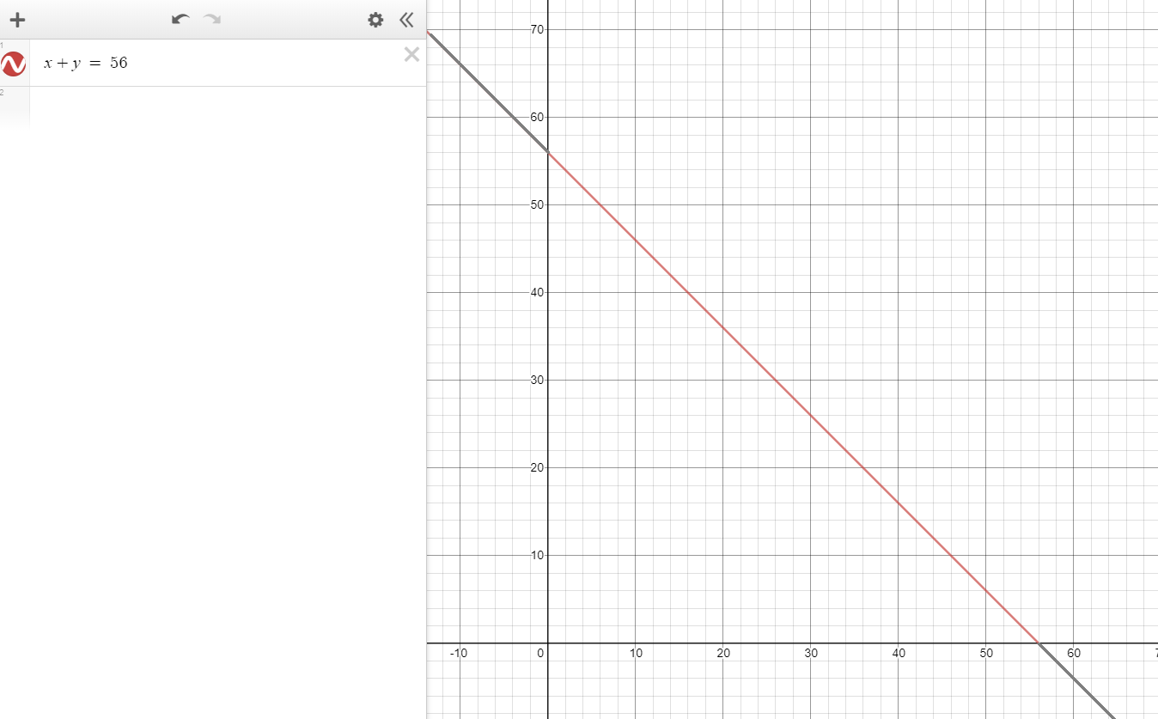

Maximum & Minimum
The sum of two positive numbers is 56. Find the two numbers if their product is to be maximum.
$x+y=56$

Slide 4

Maximum & Minimum
The sum of two positive numbers is 56. Find the two numbers if their product is to be maximum.
$x+y=56$
$x \& y are positive$
$x×y=max$

Slide 5
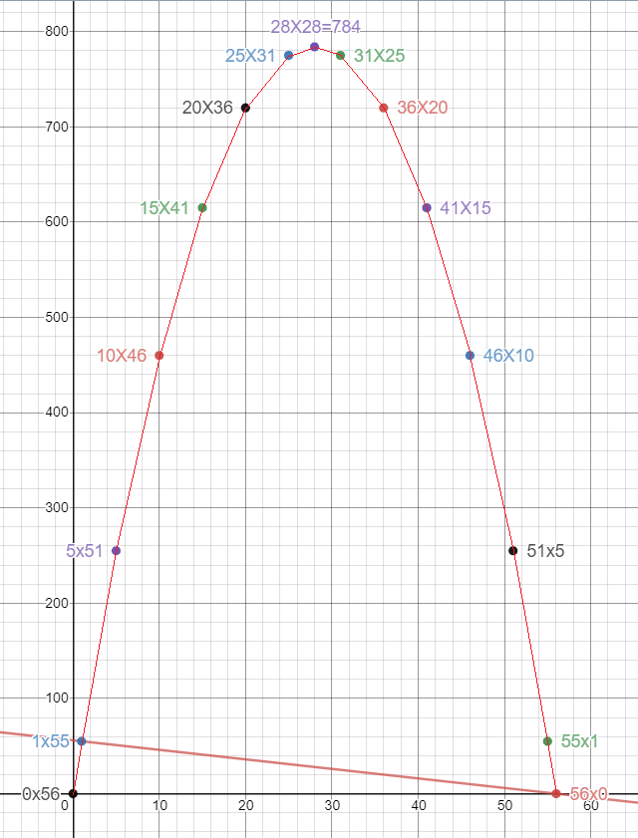

Maximum & Minimum
The sum of two positive numbers is 56. Find the two numbers if their product is to be maximum.
$x+y=56$
$x \& y are positive$
$x×y=max$
Graphically

Slide 6

Maximum & Minimum
The sum of two positive numbers is 56. Find the two numbers if their product is to be maximum.
$x+y=56$
$x \& y are positive$
$x×y=max$
Using Calculus
$max=x×y$
$x=56−y$
$max=(56−y)×y$
$max=56y−y^{2}$
Same thing for x:
$max=56x−x^{2}$

Slide 7

Maximum & Minimum
The sum of two positive numbers is 56. Find the two numbers if their product is to be maximum.
Using Calculus
$max=56y−y^{2}$
$max=56x−x^{2}$
Slop of the curve at Max = 0
Take the Derivative:
$\frac{dmax}{dy}=56−2y$
$\frac{dmax}{dx}=56−2x$

Slide 8


Maximum & Minimum
The sum of two positive numbers is 56. Find the two numbers if their product is to be maximum.
Using Calculus
$\frac{dmax}{dy}=56−2y$
$\frac{dmax}{dx}=56−2x$
$0=56−2y_{max}$
$y_{max}=\frac{56}{2}$ = 28
$0=56−2x_{max}$
$x_{max}=\frac{56}{2}$ = 28
when $x+y = 56$, ${x\&y}_{max}=28$
M$aximum=28x28=784$

Slide 9
Maximum & Minimum
References:
Ewen, D., Gary, J. S., & Trefzger, J. E. (2005). Technical calculus. Upper Saddle River, NJ: Pearson/Prentice Hall.
https://www.desmos.com/calculator/zs5wfg9uem

